Slide 1
Facing the Future in the 21st Century
Associate Professor Dr Surin Maisrikrod
Vice President
Global Engagement and Faculty Development
(Adjunct Associate Professor in Political Science, James Cook University, Australia)

Slide 2
Who are facing the 21st Century?
Young people, especially
World population = 7.6 billion
Young pop. = 1.8 billion (approx.) (10-14yrs)
Thailand: 68 million (youth, 18 million)

Slide 3
The World Economic Forum (WeForum), in Davos, Switzerland →measuring international competitiveness of countries (137)

Slide 4
1.Switzerland
2.United States
3.Singapore
4. Netherlands
5. Germany
6. Hong Kong SAR
7. Sweden
8. United Kingdom
9. Japan
10.Finland

Slide 5
11 Norway
12 Denmark
13New Zealand
14 Canada
15 Taiwan, China
16 Israel
17 United Arab Emirates
18 Austria
19 Luxembourg
20.Belgium

Slide 6
21 Australia
22 France
23 Malaysia
24 Ireland
25 Qatar
5.1 Korea, Rep.
27 China
28 Iceland
29 Estonia
30 Saudi Arabia

Slide 7
31 Czech Republic
32 Thailand
33 Chile
34 Spain
35 Azerbaijan
36 Indonesia
37 Malta
38 Russian Federation
39 Poland
40 India

Slide 8
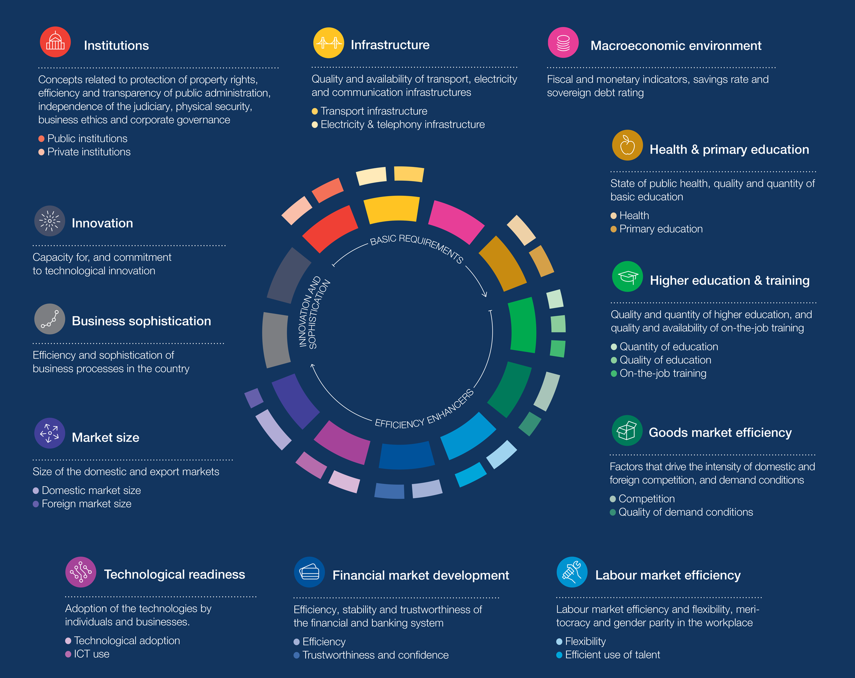

Slide 9
The Future and Future Work
Your future is shaped by FUTURE WORK
https://www.figur8.net/2017/06/17/future-work-universities-21st-century/

Slide 10
Future Work – Jobs and Universities in the 21st Century (by Shen-Li Lee)
Future Work – what will jobs look like in the future and what is the role of universities in the 21st Century?

Slide 11
According to the World Economic Forum:
“65% of children entering primary school today will end up working in completely new job types that don’t exist yet.”

Slide 12
Jobs unlikely to be taken by computer
Professional athletes – who would want to watch a sport without the uncertainty of human error or ability?
Teachers – a robot will never be able to replace the nurture of a real person.
Hotel front desk – a robot can perform all the functions required by the hotel front desk, but it will not achieve the level of personal service that a human can provide.
Chef – robots can follow recipes and cook to a greater degree of accuracy than a human, but they cannot create new recipes. What we may see is a mix of robots taking over routine chef work with the celebrity chef positions remaining open to humans.
Artists – it is easy enough for a computer to paint a picture, like the creative expressions from neural networks shown below, but these pictures are unlikely to ever hold the value of a creative masterpiece from a human artist.

Slide 13
Future Work: The Jobs Robots will Take First
So what jobs will robots take first? According to Forbes, Business Insider and Advertising Age, these ones:
Middle management
Sales people
Accountants
Report writers
Journalists
Drivers
Fashion Models
Machine operators
Umpires and Referees
Cashiers and Tellers
Legal support staff
Medical professionals and doctors

Slide 14
Future Work
Qualities Our Children Will Need
What are the qualities that determine job security? We’re looking at qualities that machines can’t replicate.
In other words – creativity and people skills.
The third skill that is going to be important is coding because someone has to create and maintain all these machines that will be replacing us.
Aside from that, coding is a skill that is increasingly becoming a necessity even in jobs outside the technology sector.

Slide 15
Future Work:
The Changing Role of University
The changes in the labour market means our children are going to need hybrid skills – for instance, combining math and arts.
New research by Burning Glass Technology analyzed millions of online job postings from the past 12 months and found that by coupling technical skills with a liberal arts education can nearly double the jobs available to graduates and offer an average salary premium of $6,000.

Slide 16
World Economic Forum, New Vision for Education (2015)
http://www3.weforum.org/docs/WEFUSA_NewVisionforEducation_Report2015.pdf

Slide 17
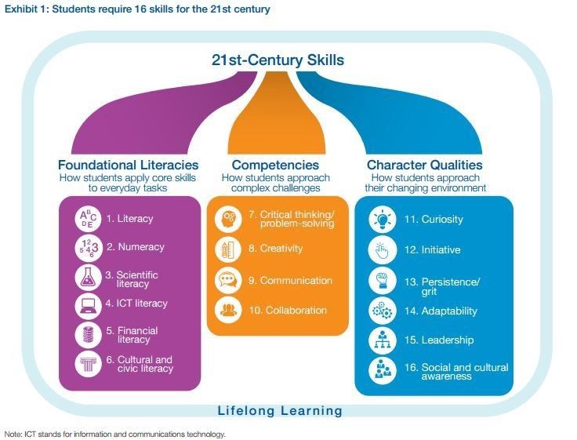

Slide 18
Learning has two parts:
1.Acquiring specific/disciplinary knowledge
2. Acquiring generic skills (21st Century Skills, any century!)→Reading, Writing, Numeracy, IT, Communication, Critical thinking, Analytical Thinking, Working in Teams, Understanding Information, Living with others, Caring for Society, etc.

Slide 19
These are skills (generic/21st century skills) that are needed for lifelong learning beyond the university.
Skills that are especially needed for the 25% of the world’s population (10-24 years of age).

Slide 20
How is Tertiary Education Changing to Address This?
Stanford University
“Stanford looks for candidates who will try to make a big difference and is willing to consider applicants who have taken risks, are innovative, and dare to be different/do things differently.”
Mission: Recently proposed the idea of a mission not a major: “I’m a biology major” is replaced by “I’m learning human biology to eliminate world hunger.”
Blended learning: At Stanford’s medical school, 70 percent of formal instruction now takes place online. This shift will become more general as Web-enhanced, blended classes become the norm.
Labs: Traditional learning is now interspersed with “impact labs” to develop entrepreneurial skills and social awareness
Entrepreneurialism as culture: Entrepreneurial DNA at the core of its culture. For example StartX is a non-profit business incubator

Slide 21
How do we teach these skills?
Teaching by not teaching →meaning change teaching methods
Rather, it is about creating different learning environments, in which students can learn by themselves →being autonomous learners
In other words, teach students to express themselves, to discover things themselves
Student-centred learning (example: children learning in Australia)
Students search and re-search for themselves→triggering their curiosity →and therefore LEARNING

Slide 22
What we are trying to do at WU
WU graduates = internationally competent
Second to none in disciplinary knowledge
Emphasize GENERIC/21st Century Skills
English proficiency is emphasized (generic skill)
Teach other generic skills

