Slide 2
Developing and implementing an academic integrity policy

Slide 3
The workshop will give:
an opportunity to attendees to:
consider established perspectives, principles and recommendations in the field of academic integrity and student plagiarism, particularly in relation to enhancing and connecting policy and practice
reflect on supporting the Suspected Academic Misconduct Procedure, identifying key issues that tend to arise from this
look at how complementary policy documentation, such as tools to support consistent decision making in managing cases might be created and used

Slide 4
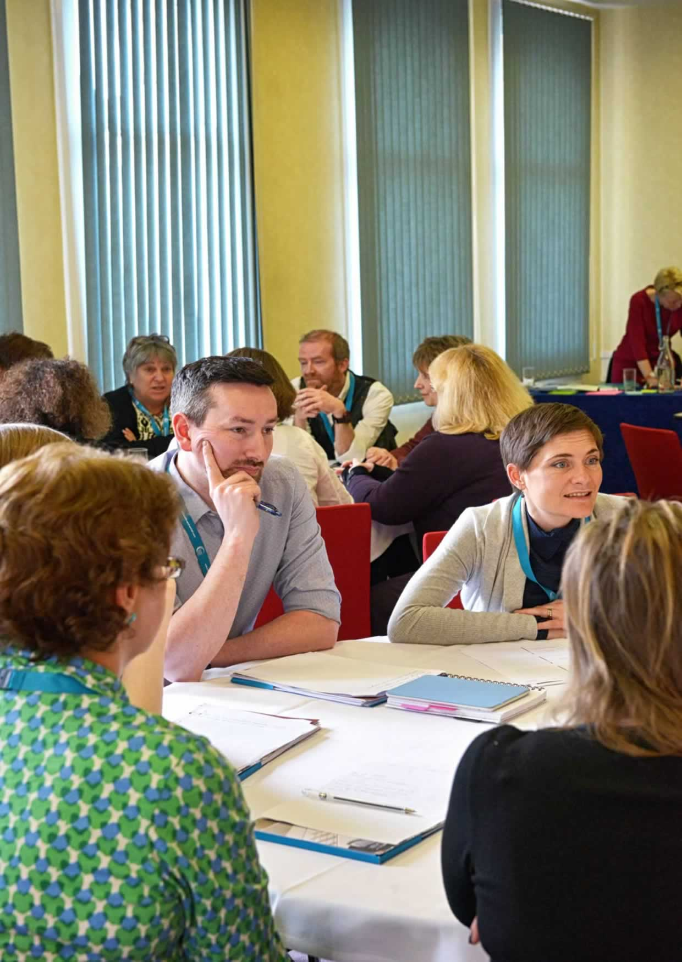
Aims of the workshop
An opportunity to:
Explore how good practice can be fostered and shared by all Suspected Academic Misconduct Officers (SAMOs) or now often called Academic Conduct Officers
Create an action plan focusing on implementing policy

Slide 5

Definition of academic integrity
“Academic integrity means acting with the values of honesty, trust, fairness, respect and responsibility in learning, teaching and research. It is important for students, teachers, researchers and all staff to act in an honest way, be responsible for their actions, and show fairness in every part of their work. Staff should be role models to students. Academic integrity is important for an individual’s and a school’s reputation”
Exemplary Academic Integrity Project (EAIP): www.unisa.edu.au/EAIP

Slide 6
A note on terminology
Process and procedure
Plagiarism prevention, avoidance and minimising risk
Plagiarism, misconduct and ‘cheating’
Case, offence
Penalty, punishment
Academic dishonesty
Code of conduct
Promoting academic integrity, culture and values
Unacceptable academic practice
Good academic practice
Outcomes
Academic honesty

Slide 7
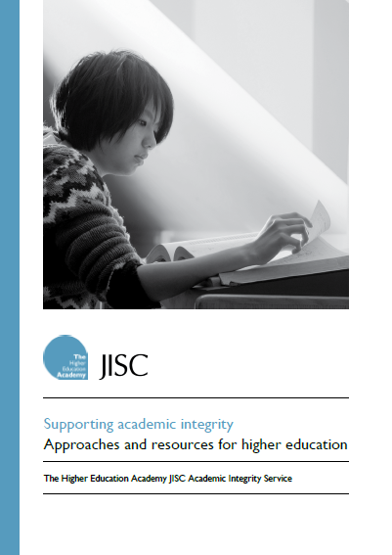
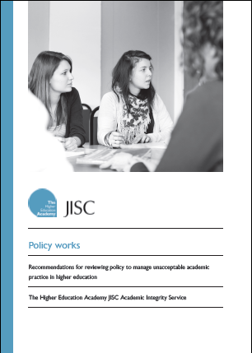
Academic Integrity Service
Initiative funded by the HEA and JISC (2009-2011)
Enhance understanding of academic integrity issues
Highlight cross disciplinary and subject-specific issues
Promote institutional approaches
  Policy development
  Educational strategies
Produce guidance
  Synthesising work
  Recommendations
  Case studies

Slide 8

Pause for paired thought
What are the reasons for unacceptable academic practice?
  Plagiarism
  Collusion
  Data fabrication

Slide 9
Reasons and explanations
Why students might plagiarise …
University policies or guidelines are not clear | Students might know about policies, but not read or understand them
Students lack skills in planning, organisation and time management | Students have under-developed skills for information literacy and learning
Students not interested in learning or subject area | Teaching is uninspiring, assessment tasks are seen as pointless
Students have difficulties with academic writing | Students not understanding citation and referencing
Other students are plagiarising | They don’t think they’ll get ‘caught’

Slide 10

Representation and relevance
Student representation in institutional working groups for developing policy and on some panels
  Plagiarism policies in the UK
  Glendinning (2013)
High proportion of students thought academic integrity had relevance to their life or work experience outside of university
  Australian academic integrity student survey
  Bretag et al (2013)

Slide 11
Policy Works
Recommendations (Morris with Carroll, 2011)
A cross-institutional group or committee | Principles and values for academic integrity and practice
Strategies to inform and educate students | Responsibilities: institution, staff, students
A central ‘academic integrity’ web area | Terminology, definitions and examples
Strategies for staff engagement and development | Clear and detailed procedures for reporting and managing cases
Explicit strategies used to help identify instances of unacceptable academic practice | Appropriate penalties
Policy documentation: well structured, easy to follow | A centralised system for recording and monitoring cases

Slide 12
Connecting policy and practice
Culture of academic integrity
Policy
Teaching and learning strategies
Review of policies and process
Academic integrity decisions
Five core elements
– access – approach
– responsibility – detail
– support
(Adapted from Bretag et al, 2011; based on East, 2009)

Slide 13
Framework for enacting policy
Core elements of exemplary academic integrity policy
  Access, Approach, Responsibility, Support, Detail
Recommendations
  Regular review of policy and process
  Academic integrity champions
  Academic integrity education for all stakeholders
  Student engagement
  Robust decision making systems
  Record keeping for evaluation
Bretag et al (2013): www.unisa.edu.au/EAIP

Slide 14
UK Quality Code for Higher Education
Indicator 7 – Students are provided with opportunities to develop an understanding of, and the necessary skills to demonstrate, good academic practice
Indicator 14 – Higher education providers operate processes for preventing, identifying, investigating and responding to unacceptable academic practice
Chapter B6: Assessment of students and the recognition of prior learning (QAA, 2013)

Slide 15
Assessing incidences, supporting decision-making
Classification framework or scheme
  Help promote consistency in decision-making across a university
  Severity or degree of seriousness of an incident based on four dimensions or criteria
    Experience of the student
    Nature of the breach
    Extent of misconduct
    Intention of student
(Yeo and Chien, 2007; Griffith University, 2011)

Slide 16

First activity: exploring issues and criteria
Stage one of the Suspected Academic Misconduct Procedure:
What kinds of key issues emerge?
Consider aggravating or mitigating factors, or other factors that are (often) relevant
Explore dimensions or criteria at play in decision making
In discussion groups; prepare for the plenary

Slide 17

Second activity
Action plans for implementing policy and sharing good practice:
Anticipated outcomes
Potential issues and challenges; strategies to address these
Approaches and ideas
Timescale, with milestones and associated activities
Resources matter
  Considerations, options ...
In discussion groups: ideas, points for action plan

Slide 18

Concluding thoughts

Slide 19
References and resources
Bretag, T. , Mahmud, S., Wallace, M., Walker, R. McGowan, U., East, J., Green, M., Partridge, L. and James, C. (2013) ‘Teach us how to do it properly!’ An Australian academic integrity student survey. Studies in Higher Education, DOI: 10.1080/03075079.2013.777406.
Bretag, T. et al (2013) Exemplary Academic Integrity Project: www.unisa.edu.au/EAIP.
Exemplary Academic Integrity Project (EAIP): Embedding and extending exemplary academic integrity policy and support frameworks across the higher education sector (2013), Plain English definition of Academic Integrity, Office for Learning and Teaching Strategic Commissioned Project 2012-2013, http: www.unisa.edu.au/EAIP.
  Glendinning, I. (2013) Plagiarism Policies in the United Kingdom: Full report. Impact of Policies for Plagiarism in Higher Education Across Europe (IPPHEAE). Available from: http://ippheae.eu/
  Griffith University (2011) Institutional Framework for Promoting Academic Integrity Among Students.
Morris, E. with Carroll, J. (2011) Policy works: recommendations for reviewing policy to manage unacceptable academic practice in higher education. The Academy JISC Academic Integrity Service, The Higher Education Academy. Available from: www.heacademy.ac.uk/academic-integrity.
Morris. E. (2010) Supporting Academic Integrity: Approaches and resources for higher education. The Academy JISC Academic Integrity Service, The Higher Education Academy. Available from: www.heacademy.ac.uk/academic-integrity.
  Power, L. G. (2009) University Students’ Perceptions of Plagiarism. The Journal of Higher Education, 80 (6), 643-662.
  Sutherland-Smith, W. (2008) Plagiarism, the Internet and Student Learning: Improving Academic Integrity. New York and London: Routledge.
QAA (2013) UK Quality Code for Higher Education. Part B: Assuring and enhancing academic quality. Chapter B6: Assessment of students and the recognition of prior learning. Available from: http://www.qaa.ac.uk/Publications/InformationAndGuidance/Documents/B6.pdf
Yeo, S. and Chien, R. (2007) Evaluation of a Process and Proforma for making Consistent Decisions about the Seriousness of Plagiarism Incidents. Quality in Higher Education, 13, 2, 187-204.

